Slide 1


Sickle blades
Shape analysis on sickle blades:
Clustering on sickle blades
Clustering on sites having these sickle blades
https://github.com/zoometh/Rdev/tree/master/gmm/sickles
01/10/2023
Thomas Huet & Niccolo Mazzucco

Slide 2
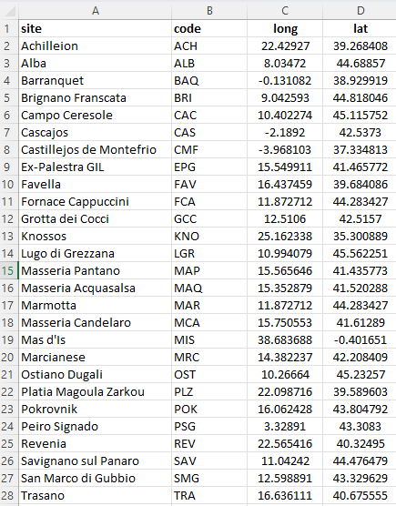
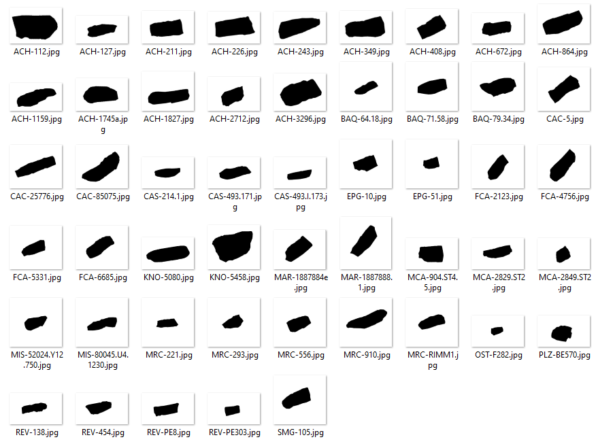
Dataset
Listing of sickles blades, with site, site code and coordinates, XLSX file
Sickles blades drawings, JPG files (n = 50)

Slide 3
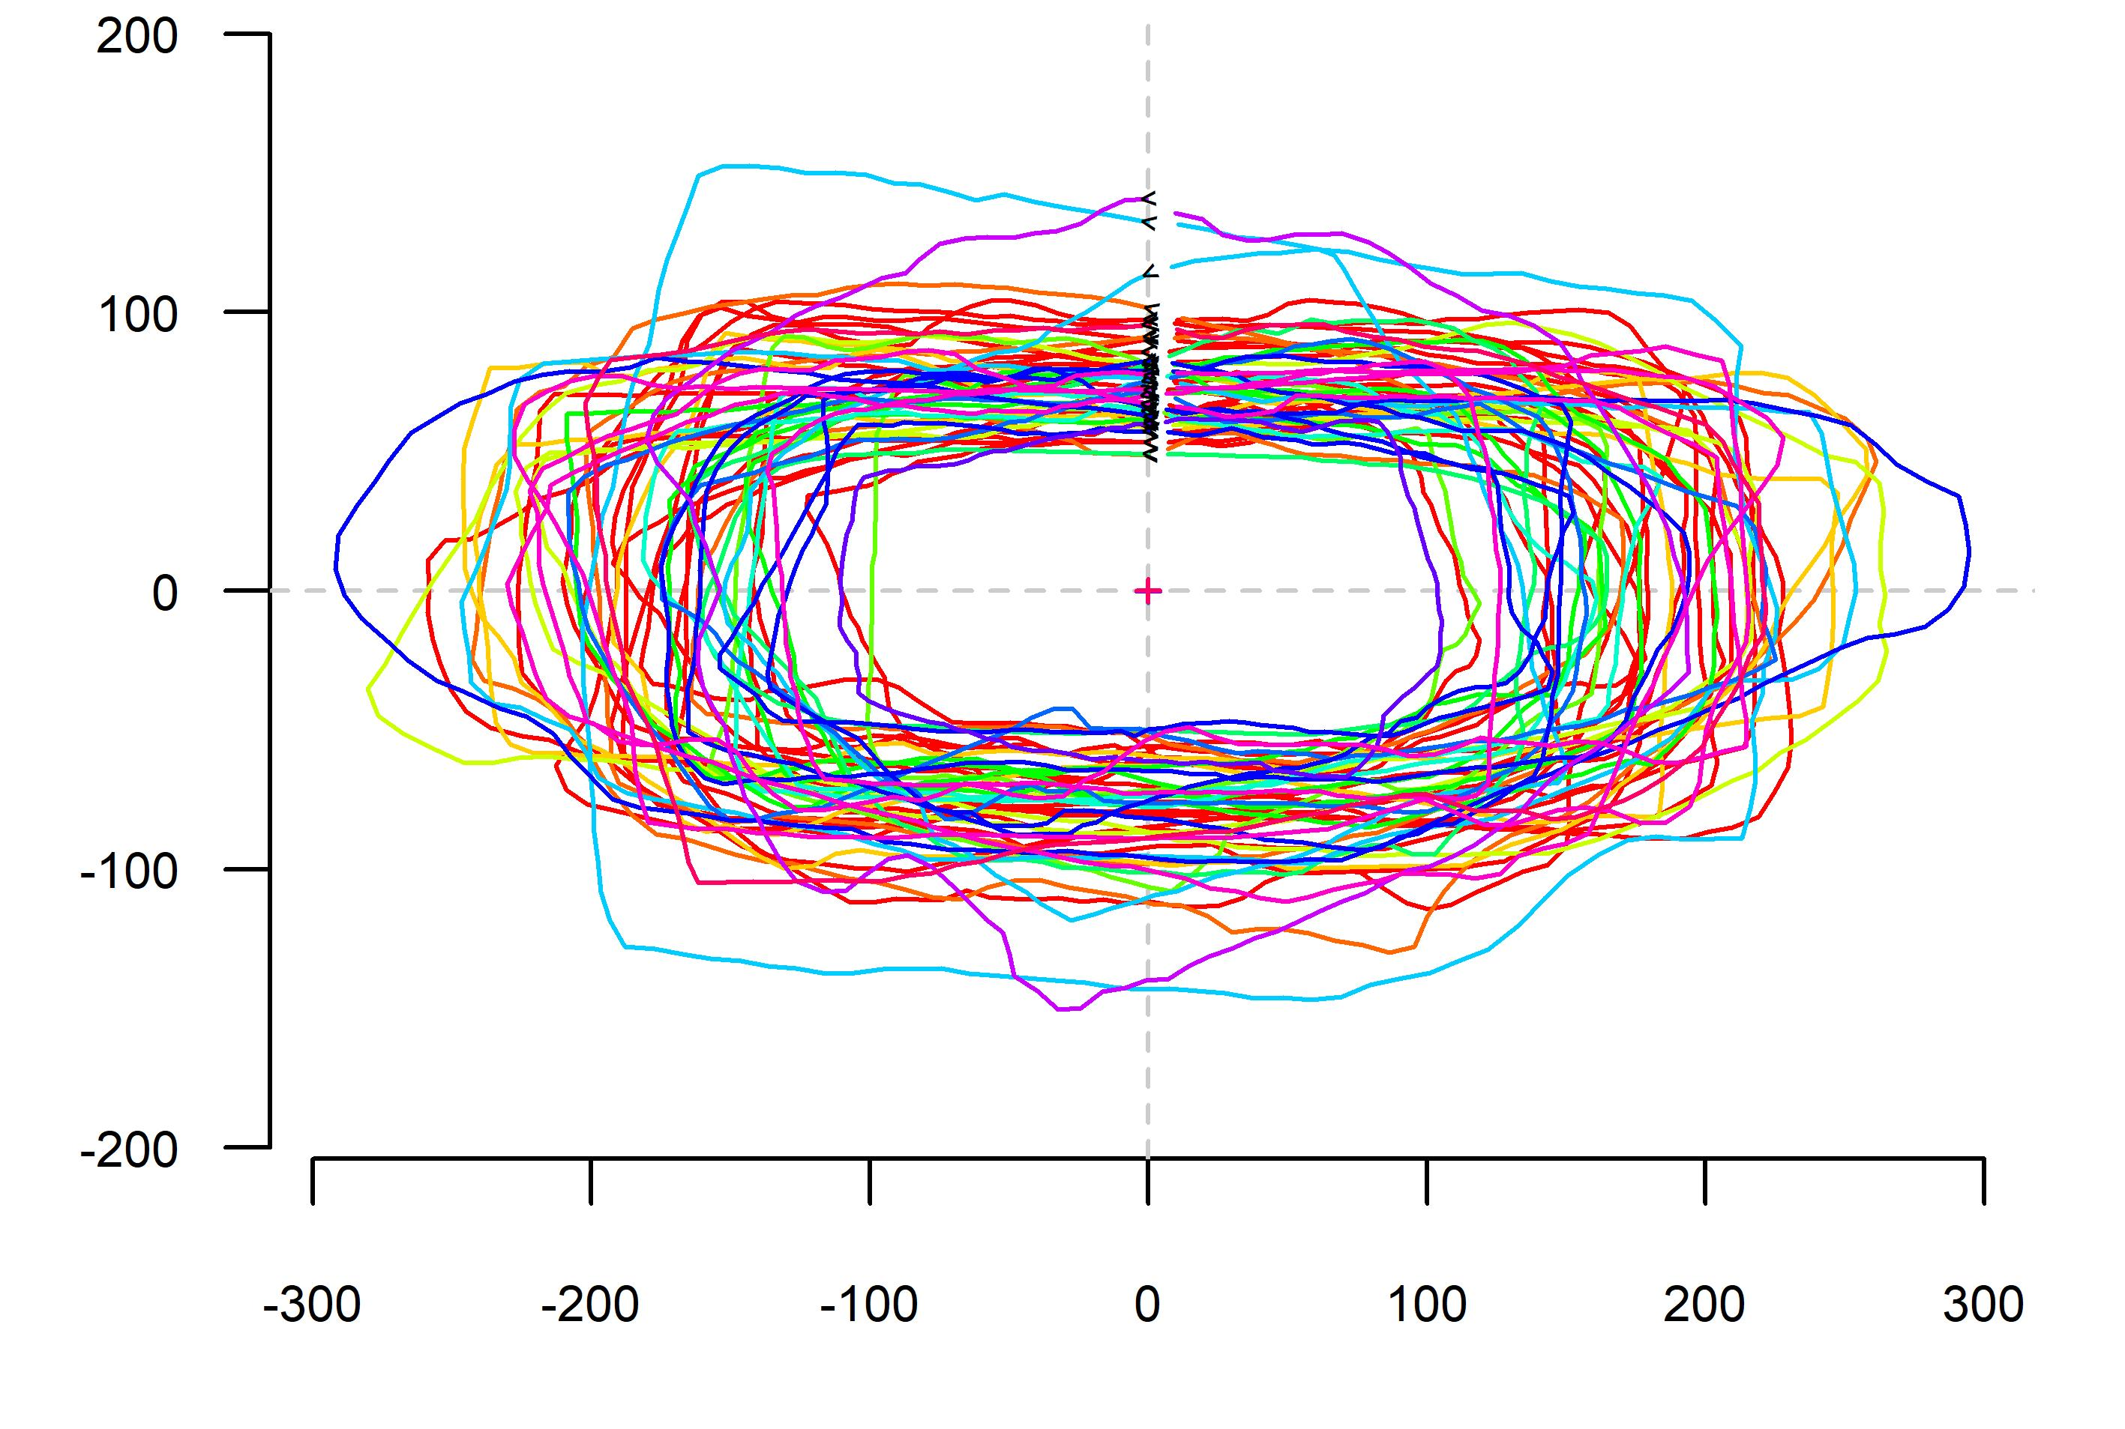
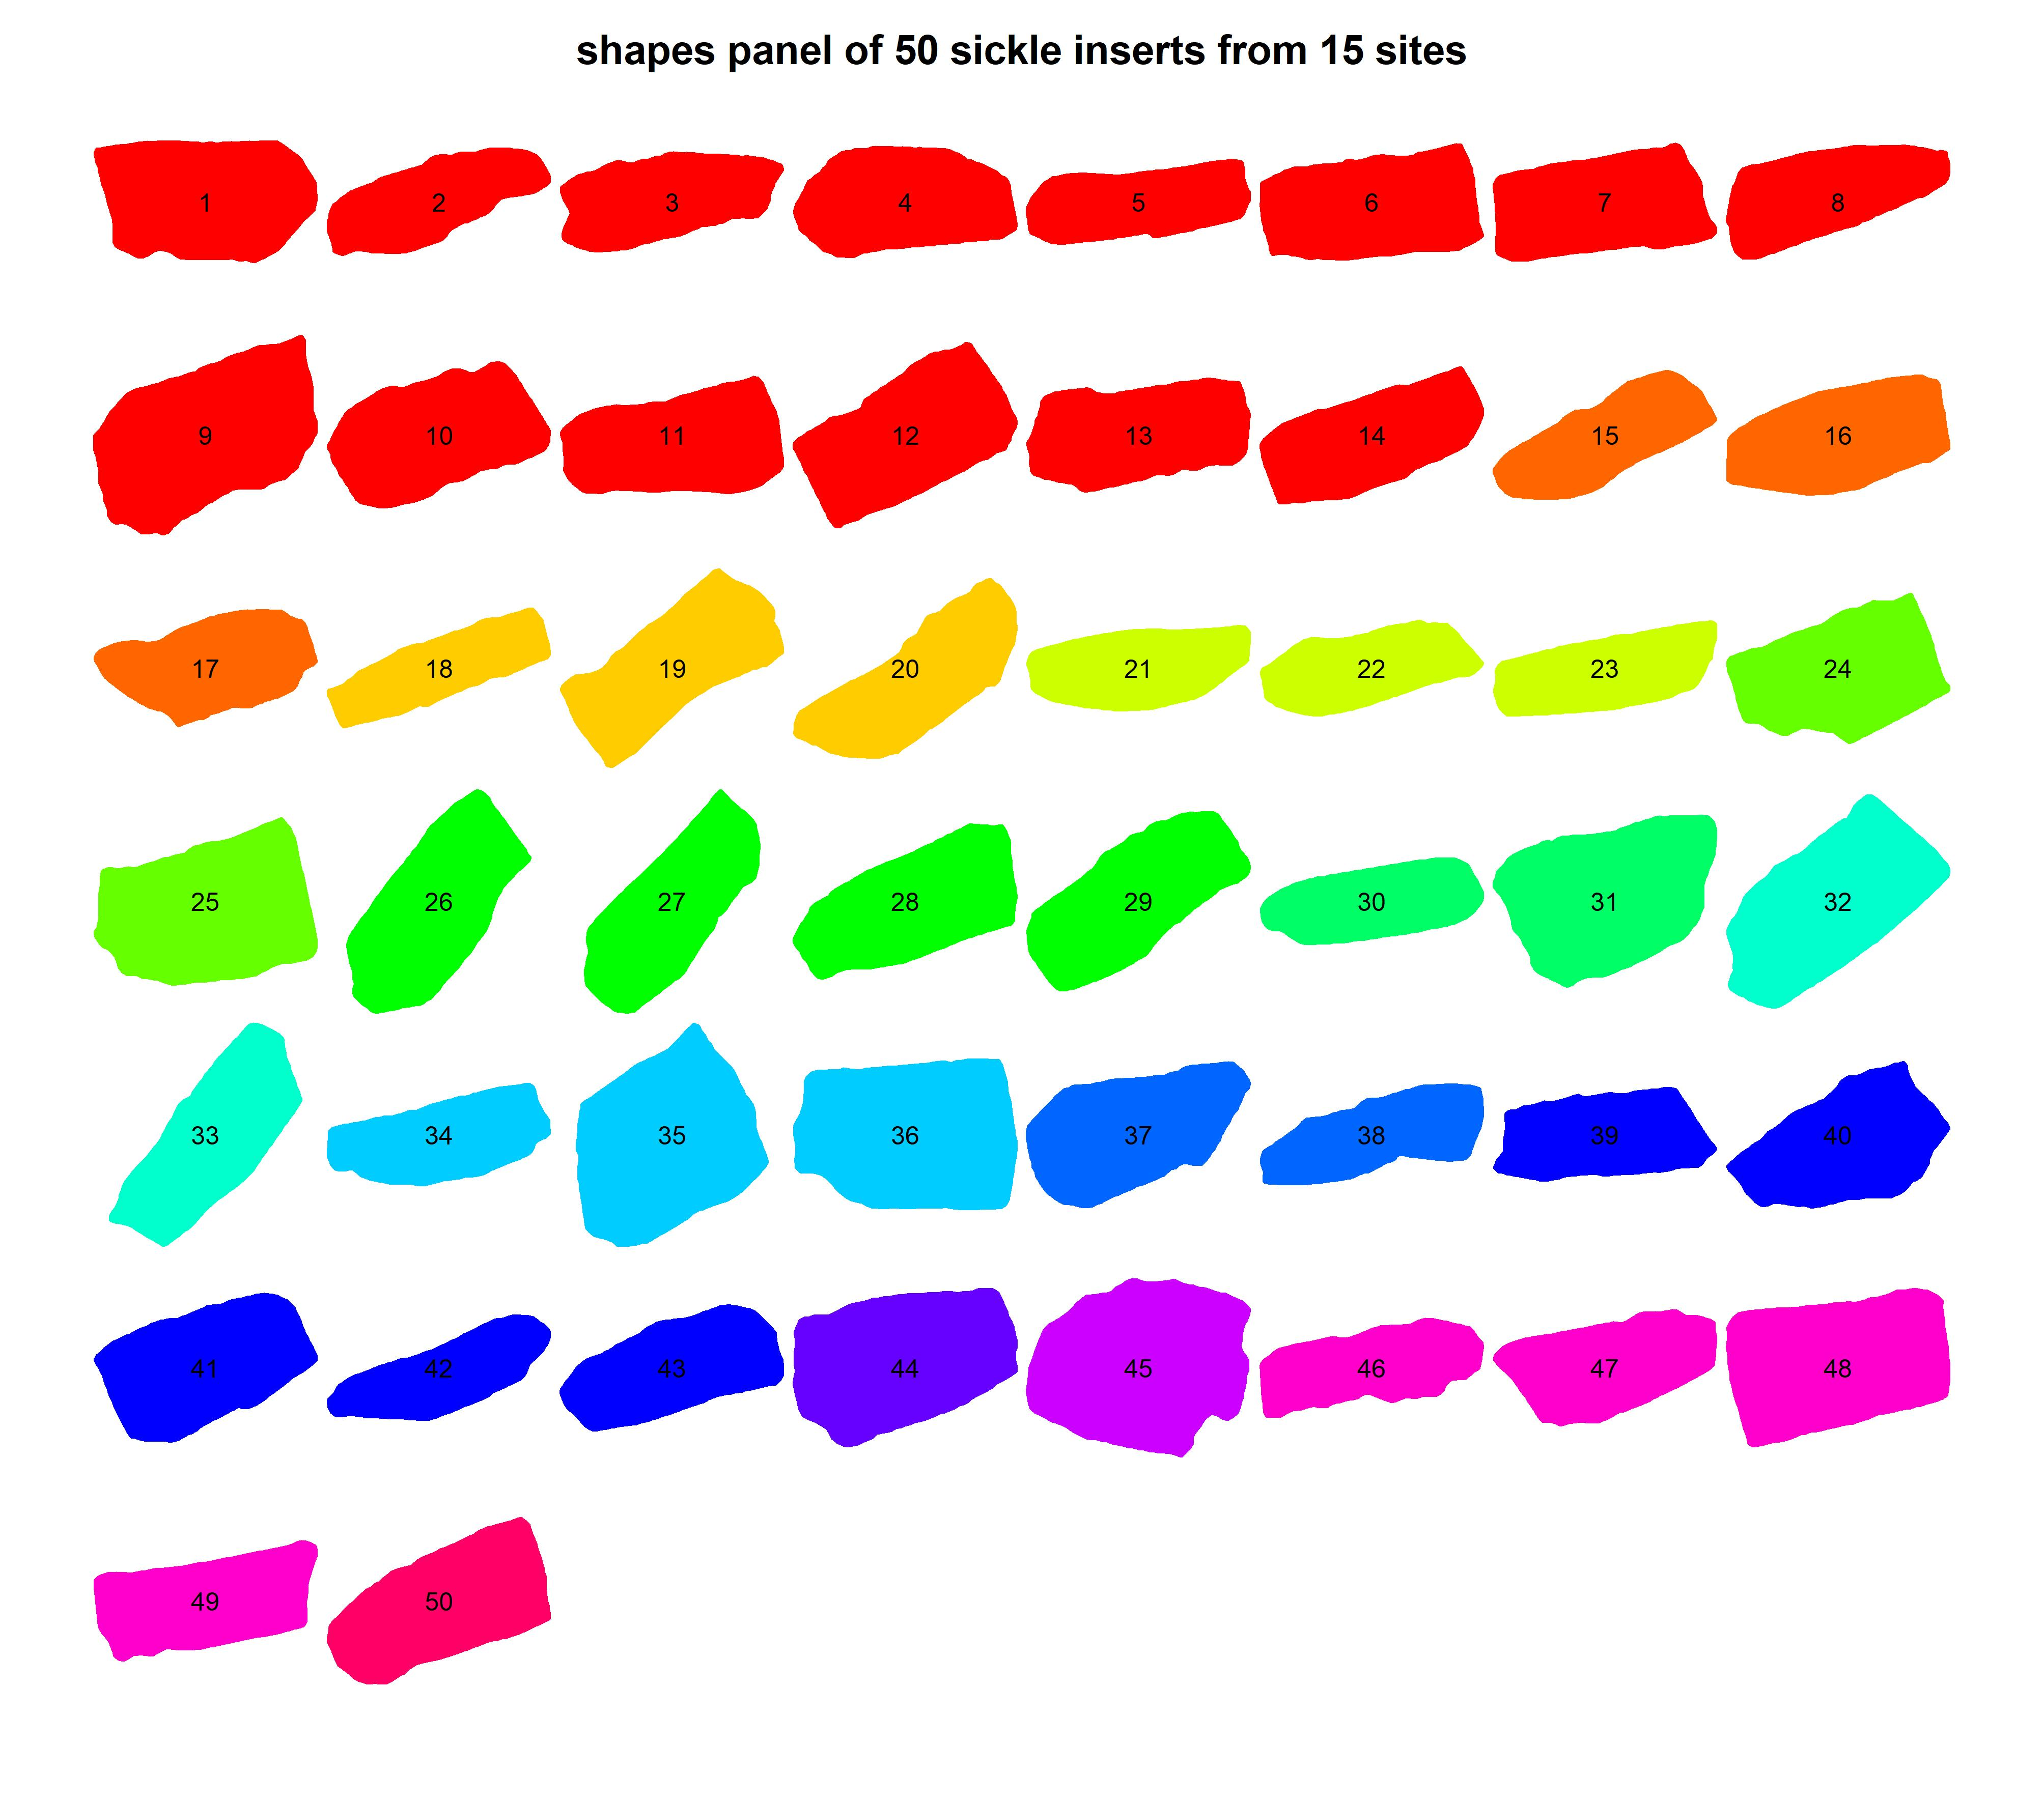
Shapes description
Stack on sickles blades coloured according to their sites
Panel on sickles blades coloured according to their sites

Slide 4
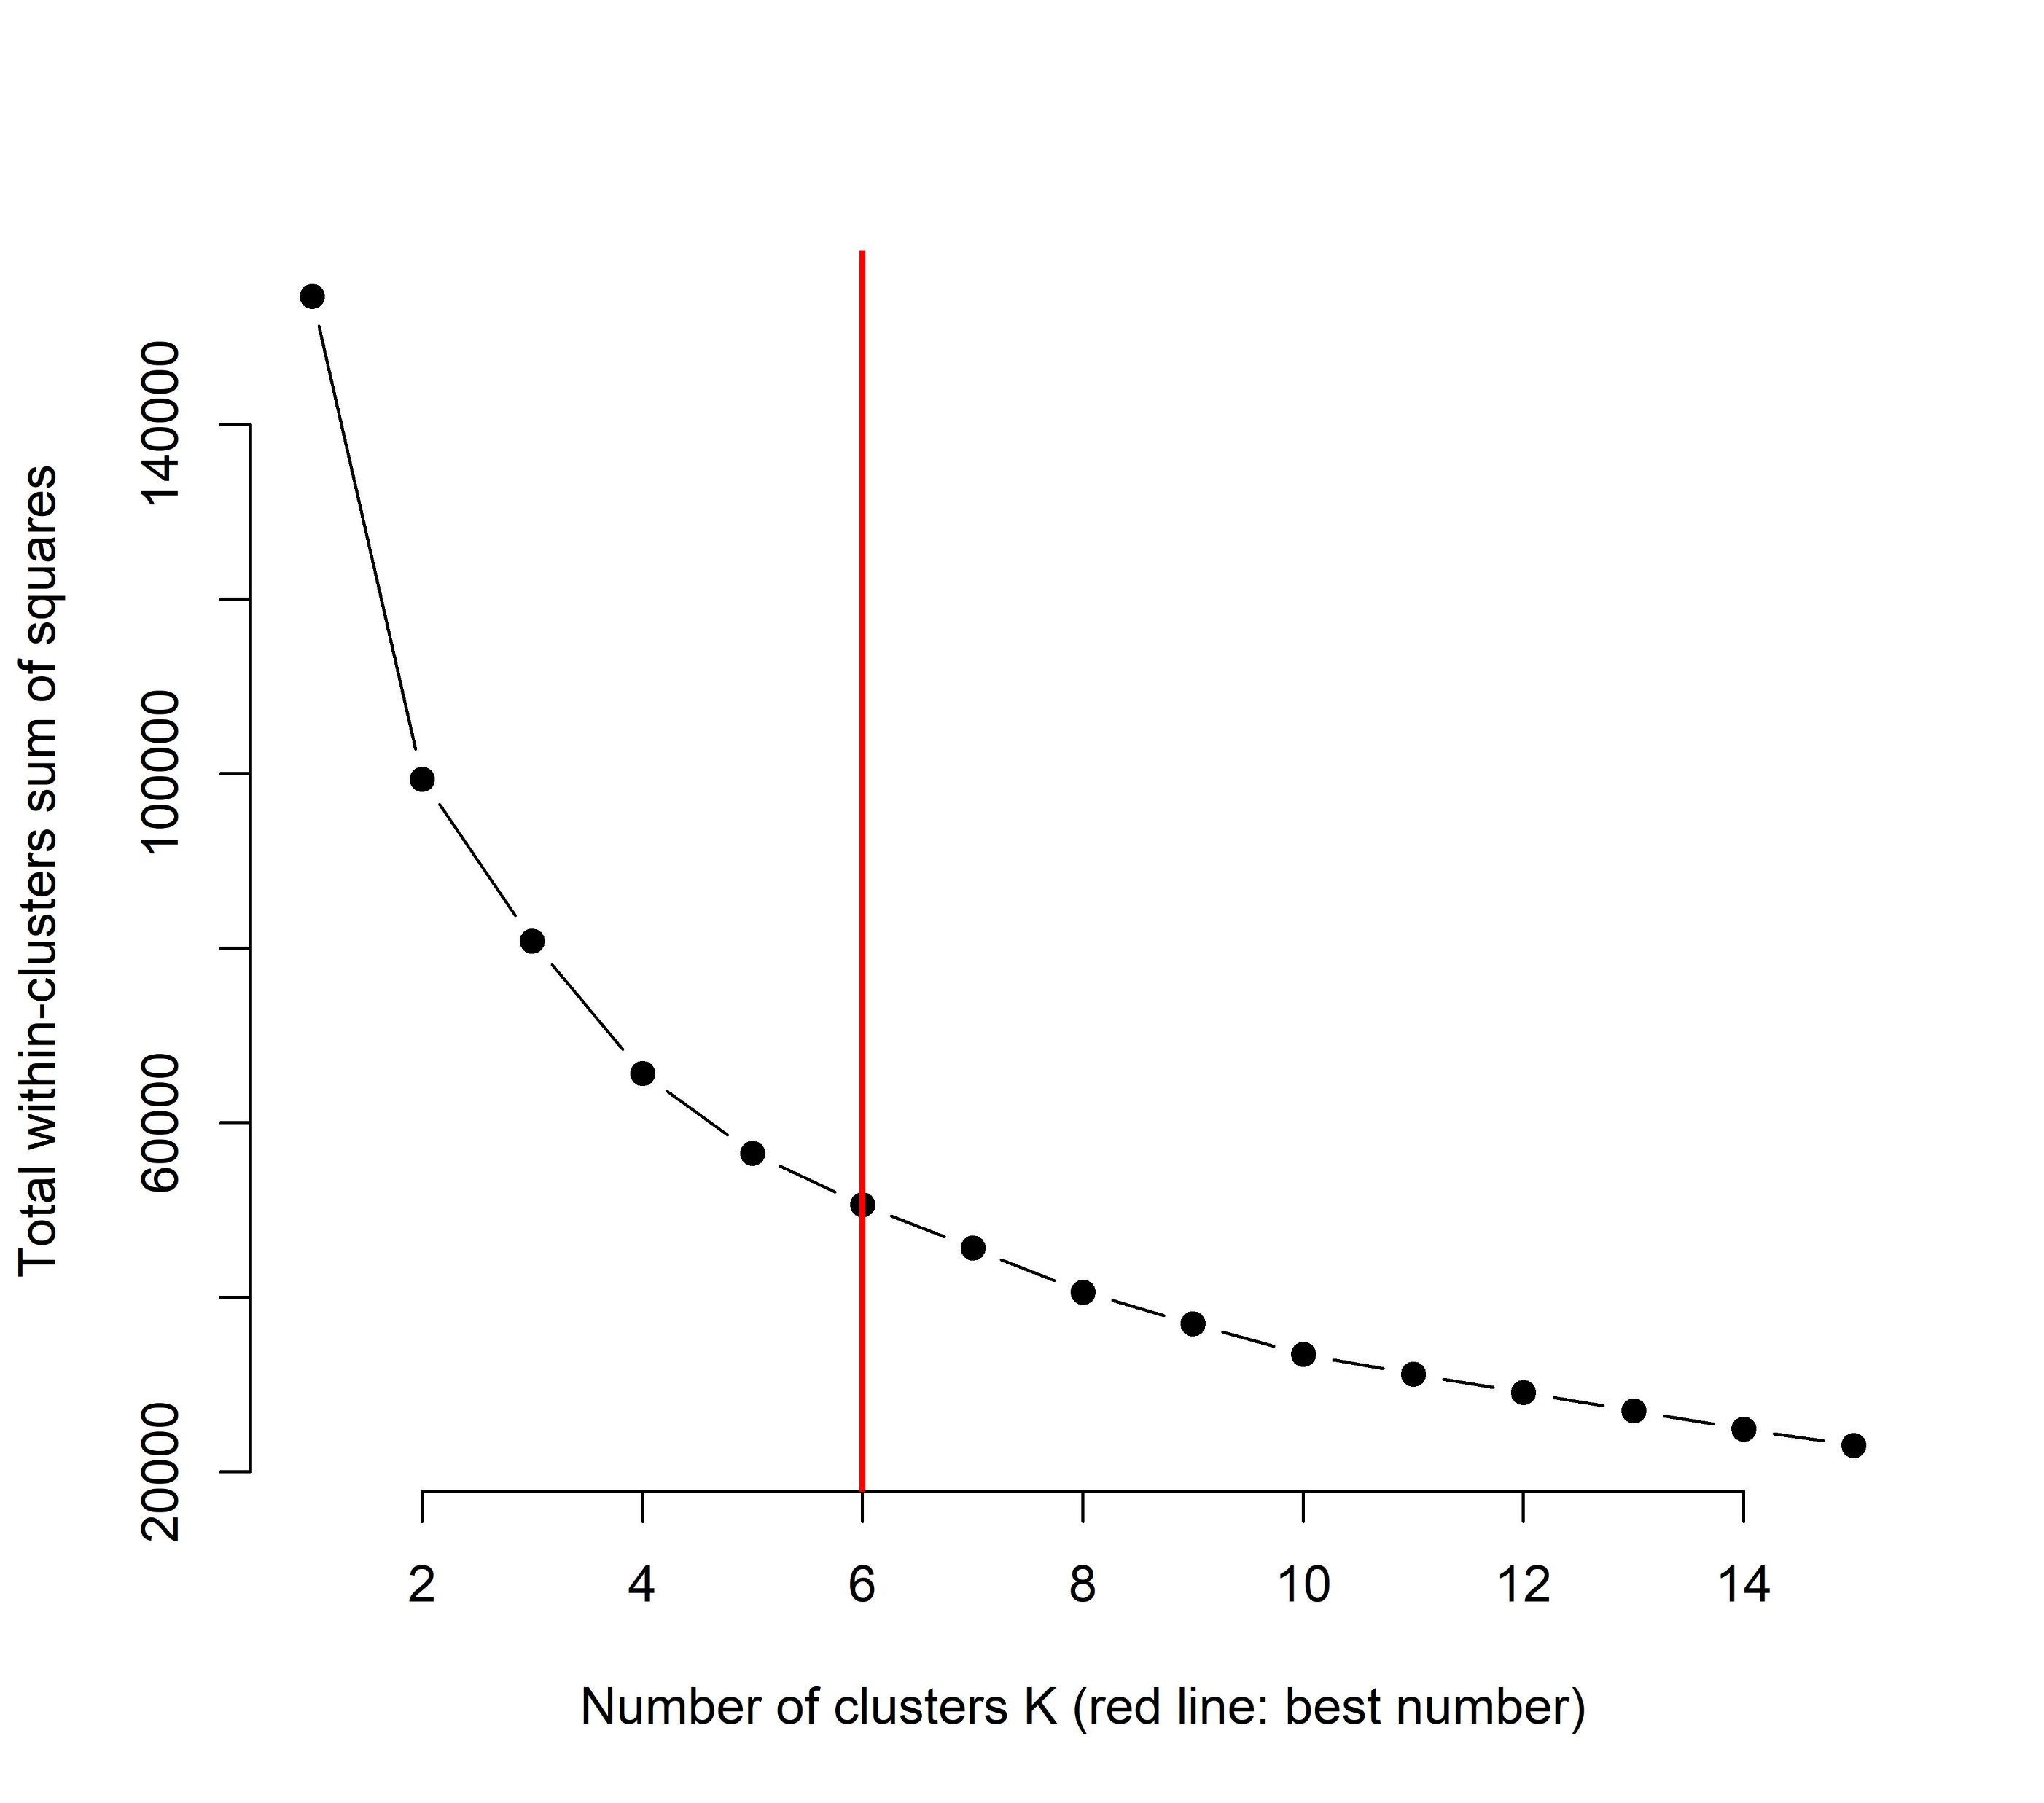
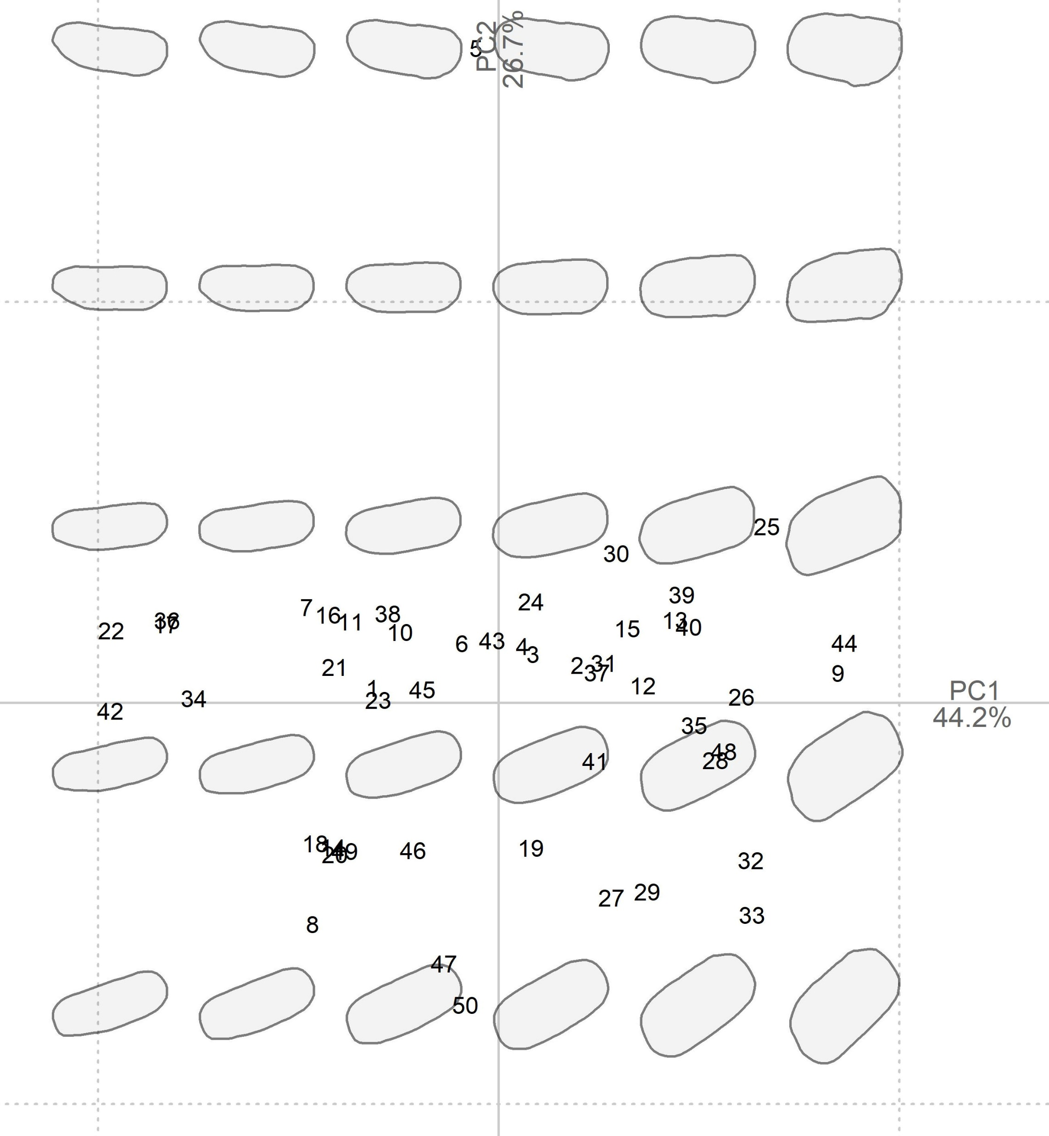
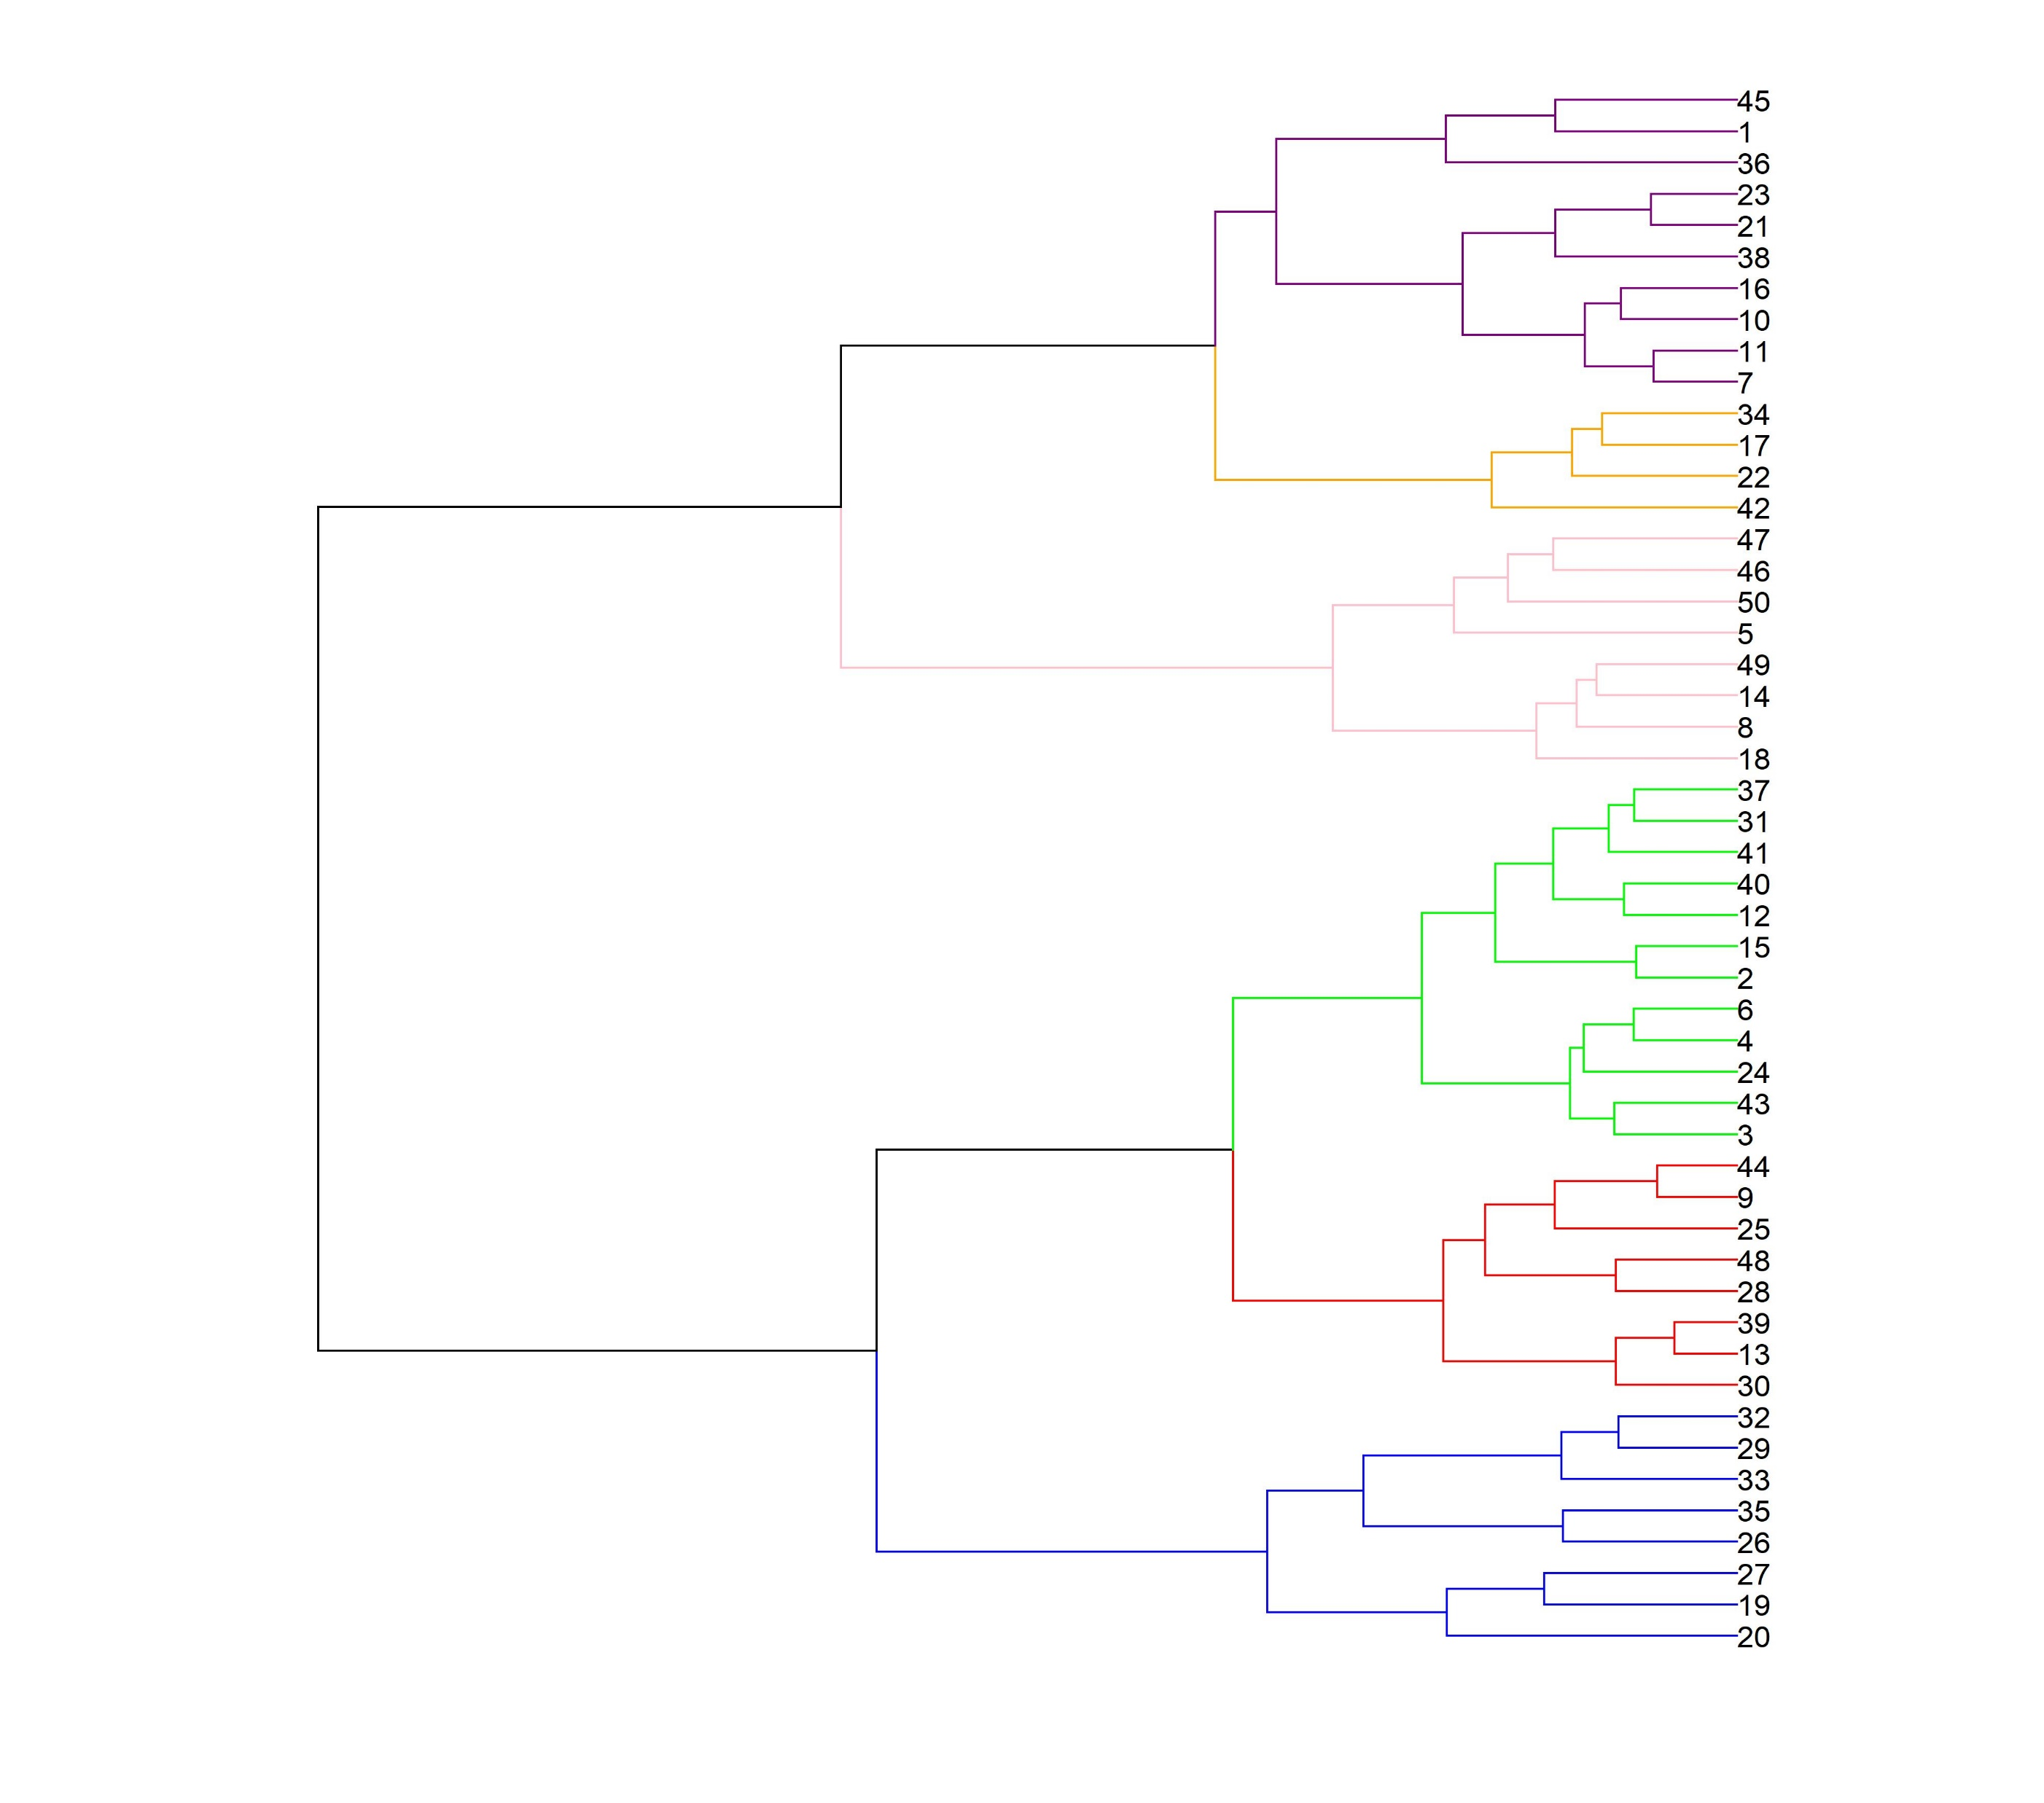
Optimal number of clusters (n = 6 clusters)
Shapes clustering
PCA on sickles blades with sickle blades numbers and mean shapes
Hierarchical clustering on sickles blades coloured according to their cluster (n = 6 clusters)

Slide 5
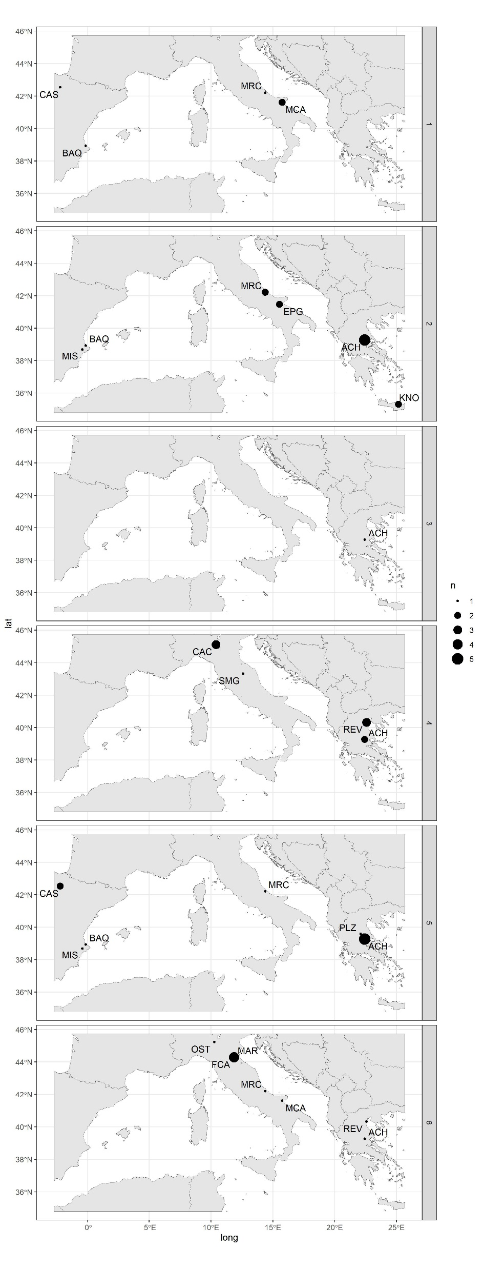
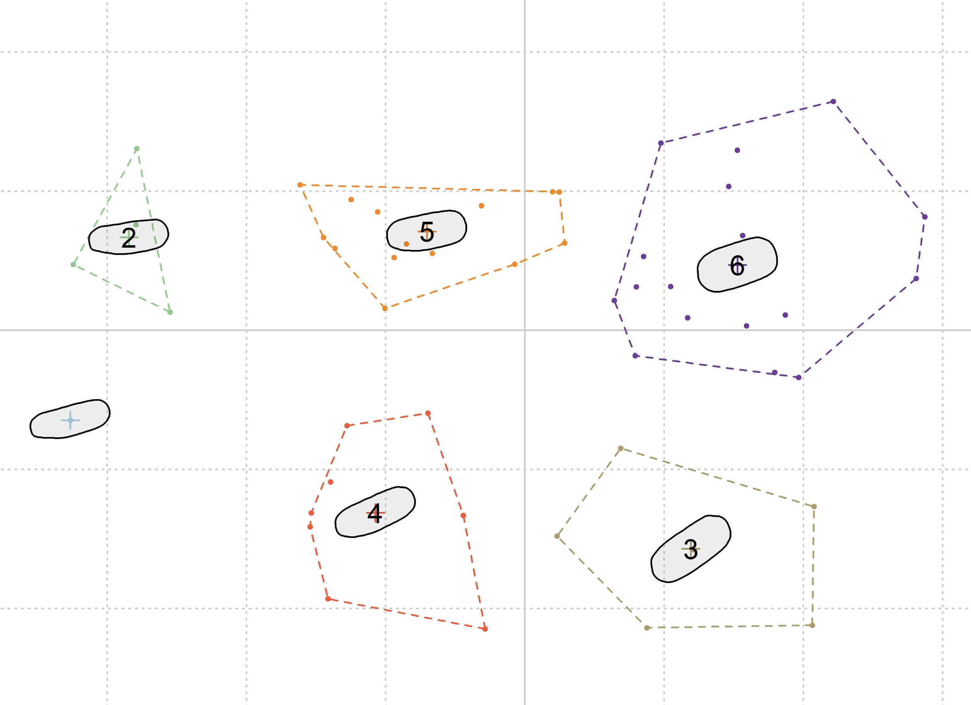
Shapes clustering
Kmeans on sickles blades with cluster blades numbers, clusters mean shapes, coloured according to their cluster (n = 6 clusters)
Spatialisation of sickles blades according to their Kmeans cluster (n = 6 clusters)

Slide 6
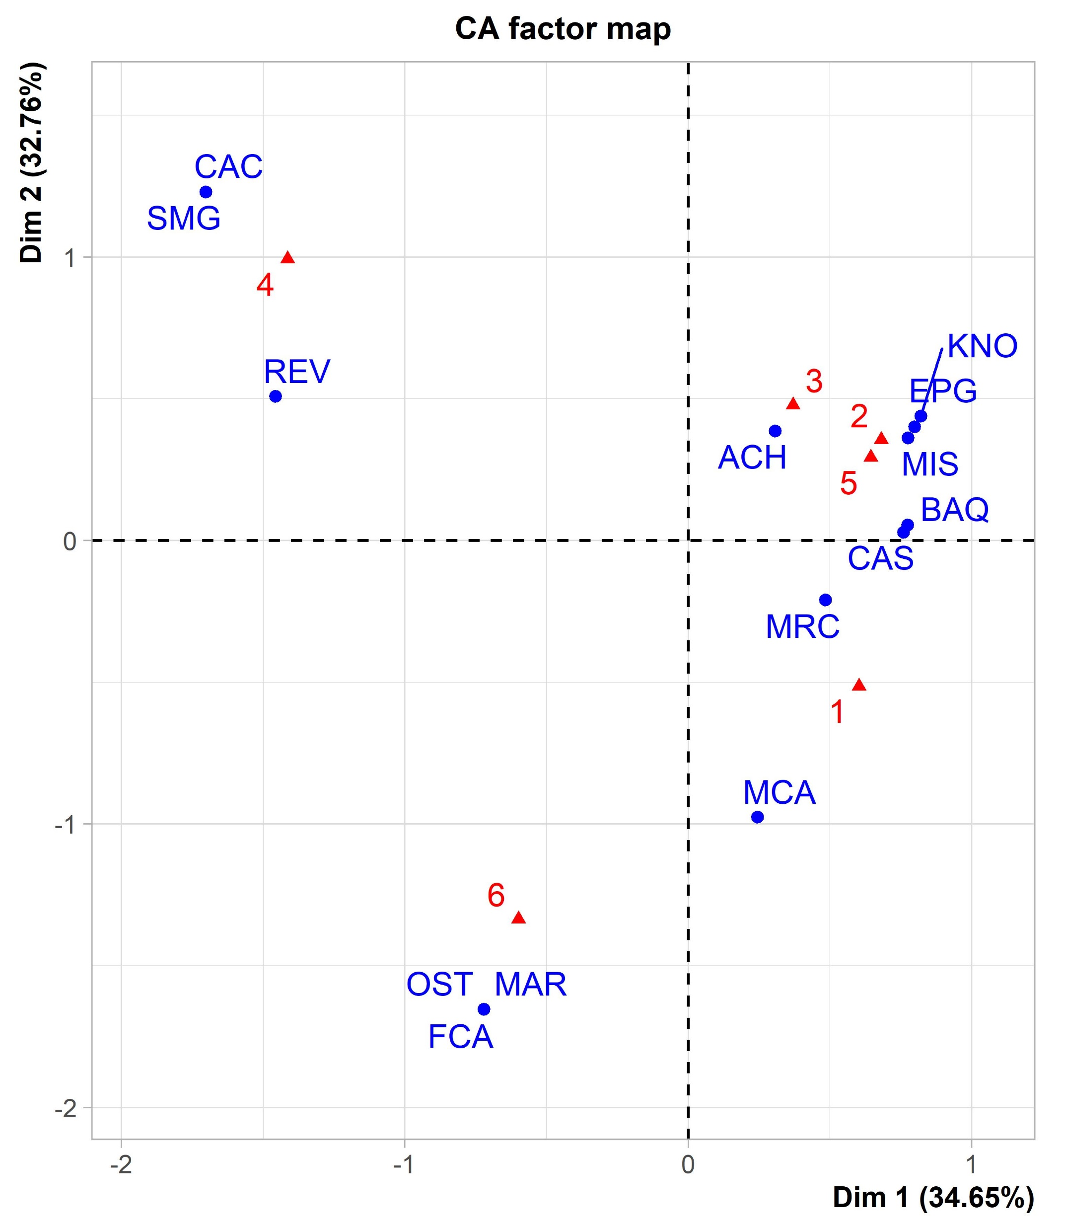
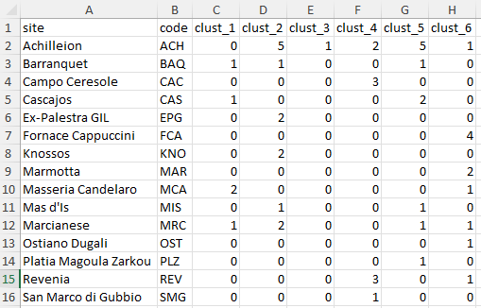
Sites clustering
Sites with number of sickle blades in each cluster (n = 6 clusters)
Correspondance Analysis (CA) on archaeological sites

Slide 7
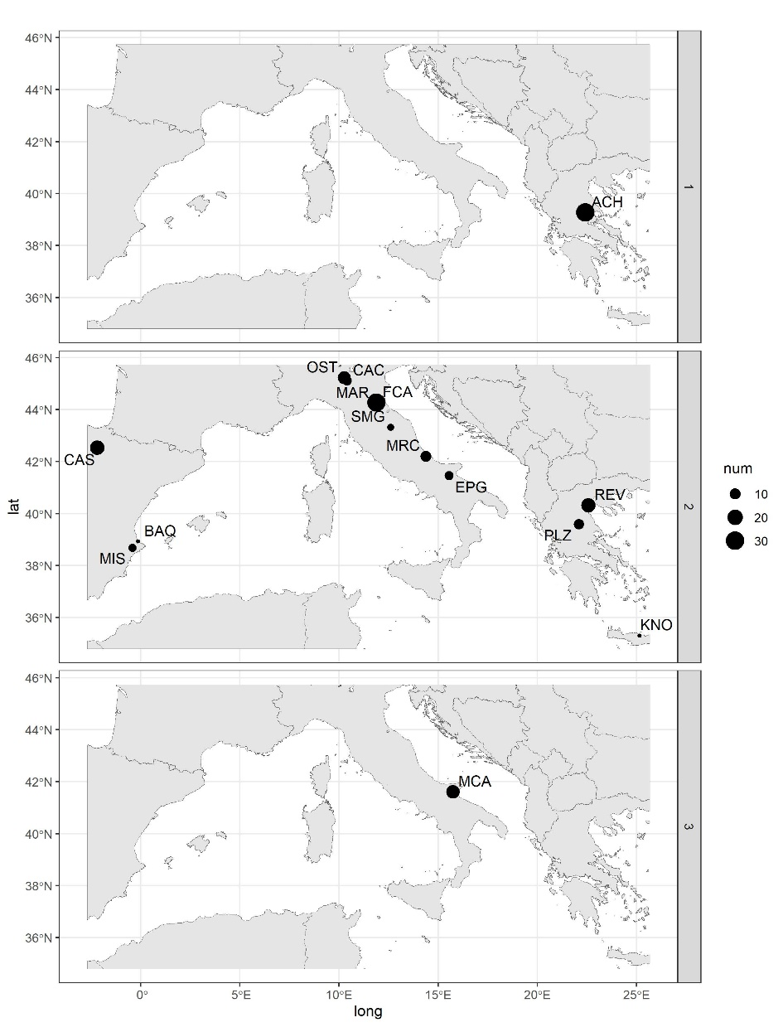
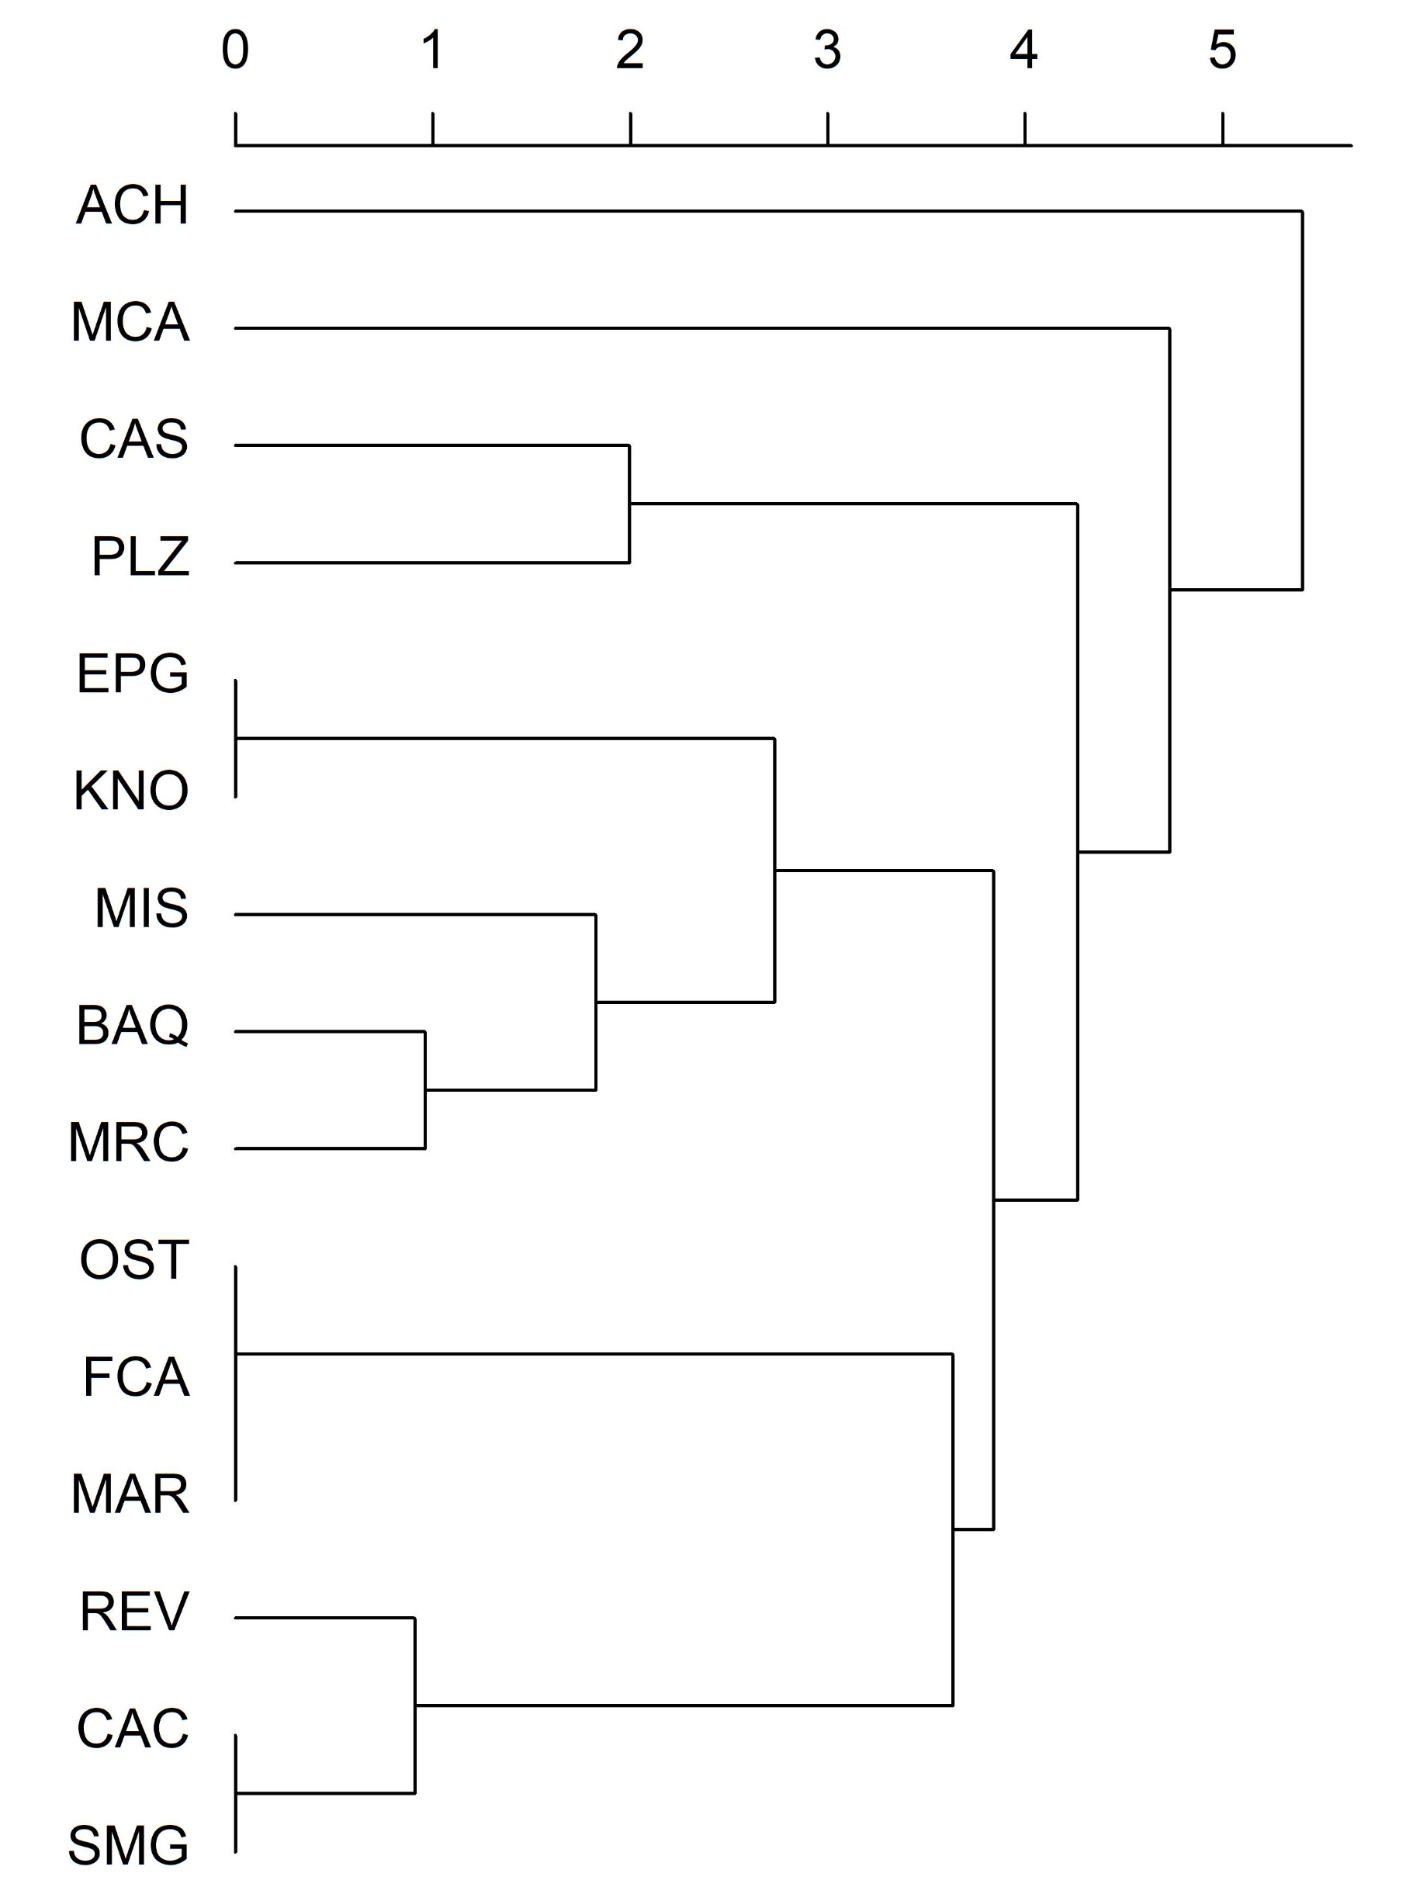
Sites clustering
Hierarchical clustering on sites
Spatialisation of sites according to their CA cluster (n = 3 clusters)

